Slide 1
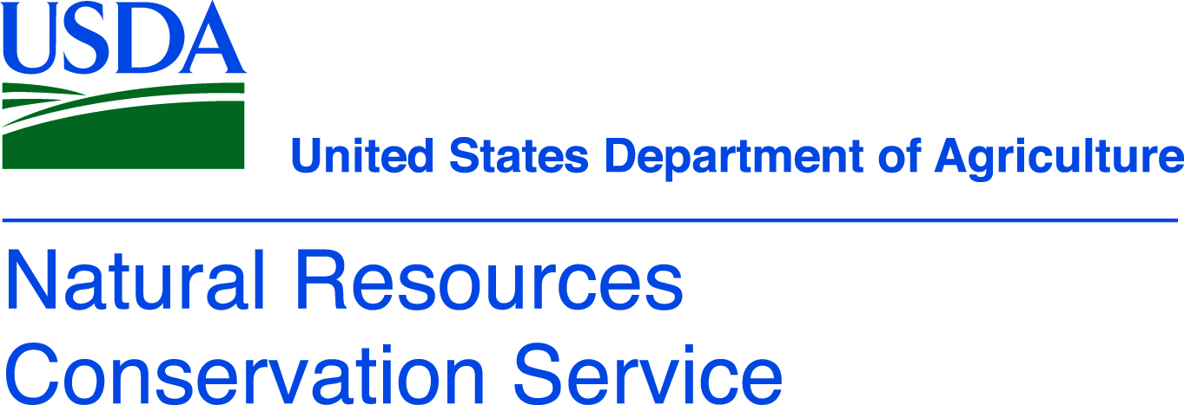
Why Are Soils Important?

Slide 2
Soil profile

Slide 3
What is soil made of?
Organic Matter
Mineral Matter
Air
Water

Slide 4
What is soil?
The skin of the Earth
Can be millimeters thick when subjected to wind or water erosion
Can be meters thick when in protected or stable places
Mix of organic matter, sand, silt, and clay particles

Slide 5
How do soils form?
Chemical processes
breakdown of rocks through a change in their chemical makeup. This can happen when the minerals within rocks react with water, air or other chemicals.
Physical processes
breakdown of rocks from the result of a mechanical action.
temperature changes.
abrasion (when rocks collide with each other).
frost can all cause rocks to break down.
Biological processes
the breakdown of rocks by living things.
lichens produce acids to breakdown rock and allow them to secure themselves to the surface.
plant roots can grow into cracks in the rock, making it split.
burrowing animals help water and air get into rock.
accumulation of organic matter as plants, animals, fungi, bacteria and other organisms die.
living organisms continue to colonize the new soils building a habitat and ecosystem.

Slide 6
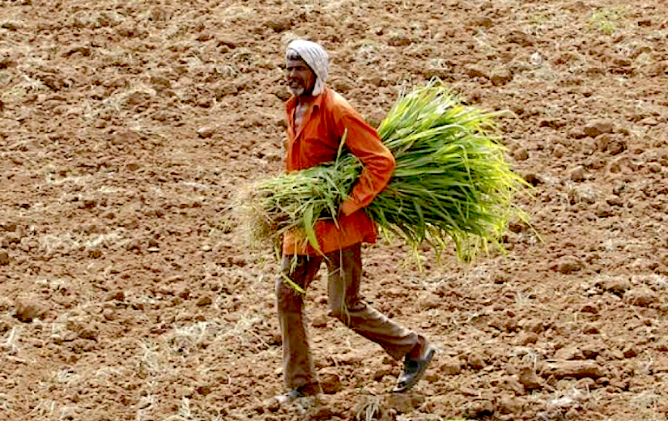
Soils are under threat
Overexploitation, overcultivation, over harvesting
When crops are harvested and little or no biomass is returned to maintain healthy levels of organic matter
This can lead to poorer yields year after year or the need to supplement with more and more fertilizers
A sufficiently high organic matter level is important to increase soil stability, soil water holding capacity and the nutrient holding capacity and supply

Slide 7
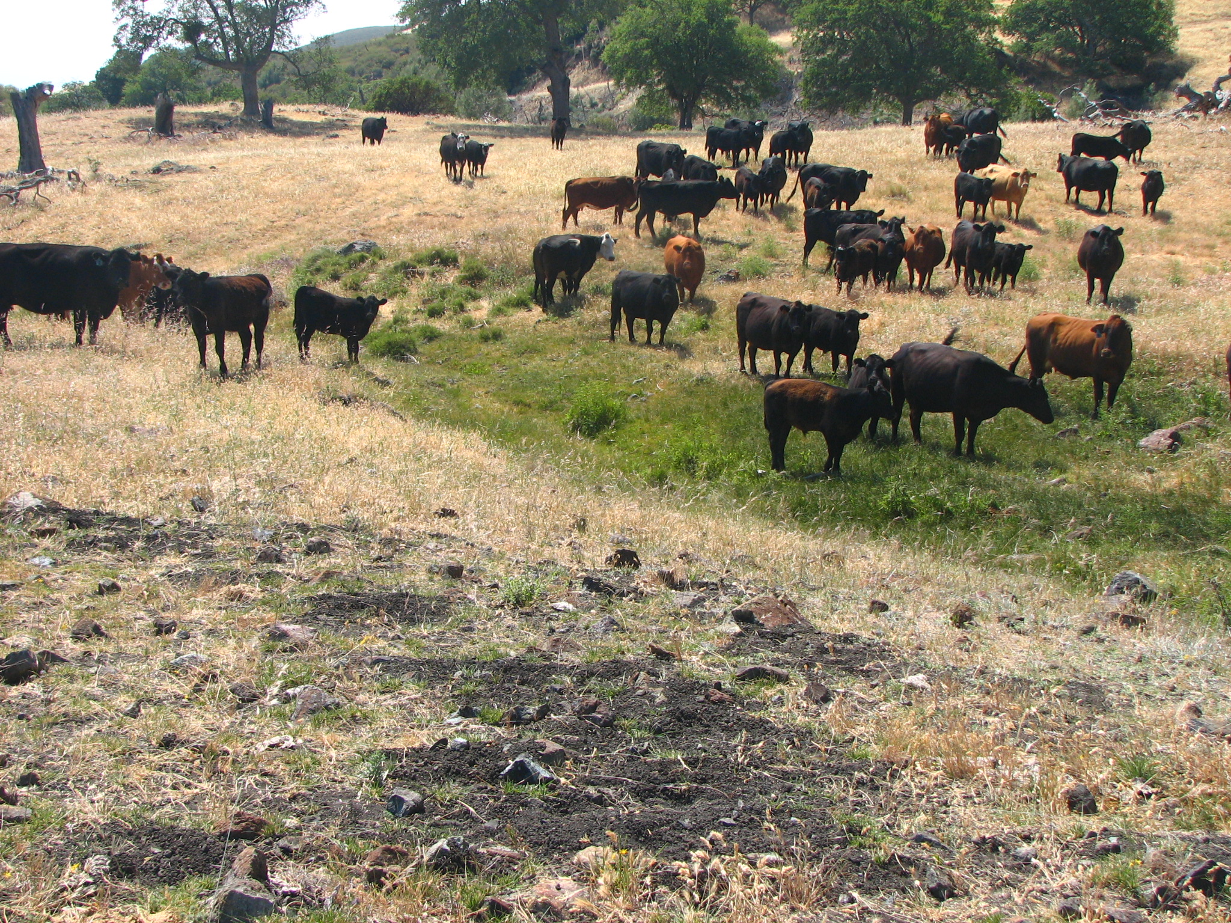
Soils are under threat
Overgrazing
When livestock are left on a section of land for too long and graze plants to a level where they cannot recover
Perennial grasses that cannot handle the grazing pressure might get replaced with annual weeds
This can lead to bare soil, soil erosion, unhealthy plant communities, and loss of habitat

Slide 8
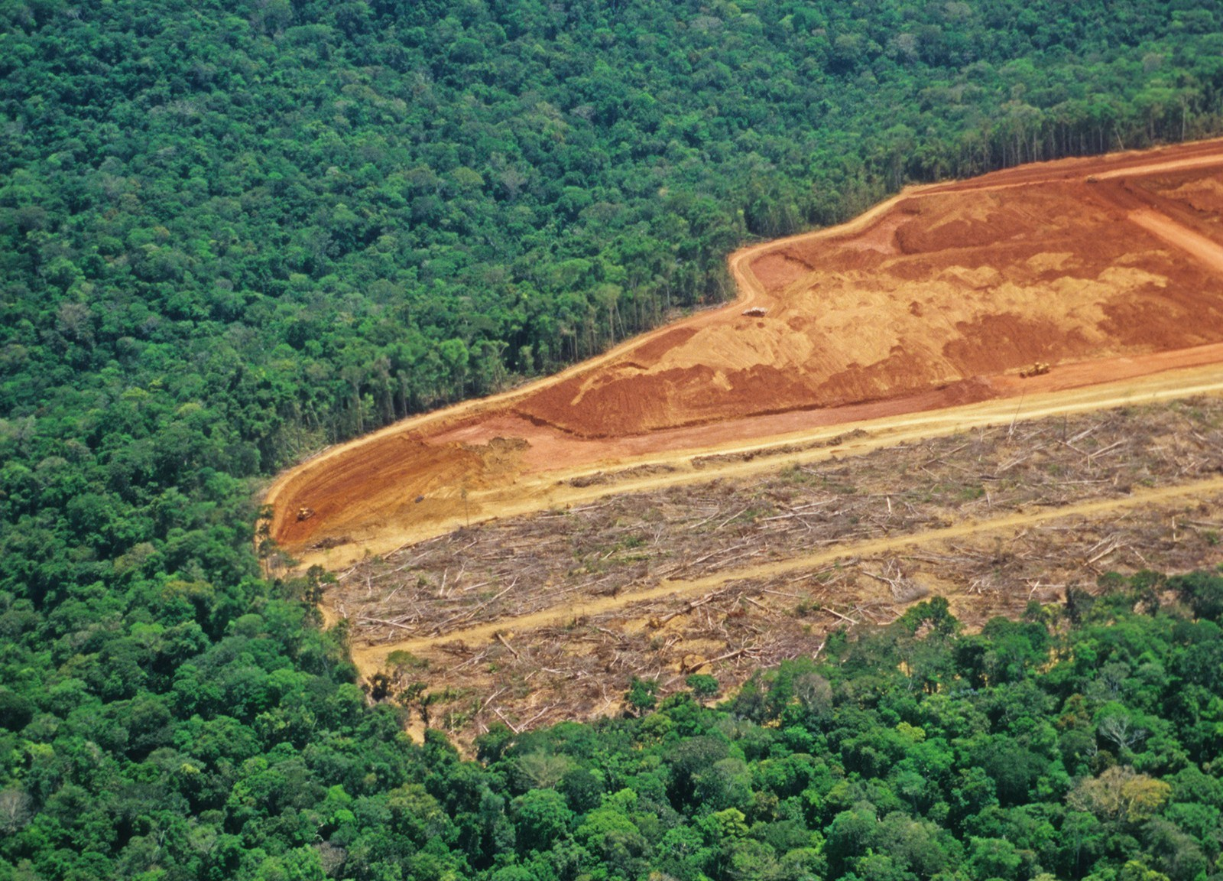
Soils are under threat
Fire; Clear cutting, Deforestation
Leaves little or no natural vegetation on the soils

Slide 9
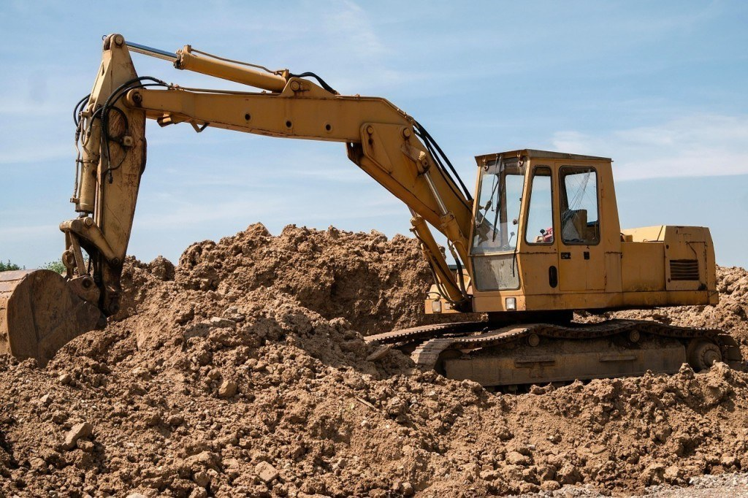
Soils are under threat
Industrial activities
Mining
Construction
Soil profile is disturbed and subsoil that does not have organic matter can be brought to the surface

Slide 10
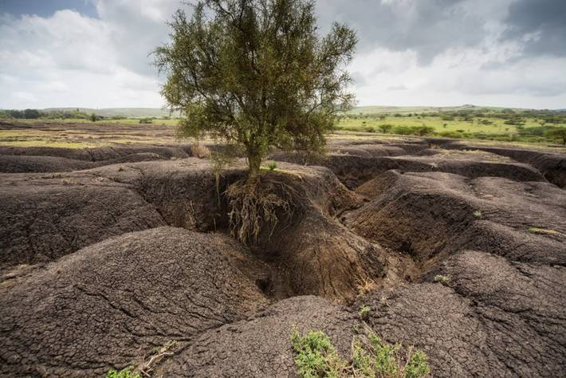
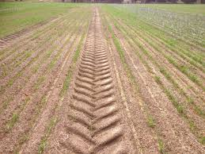
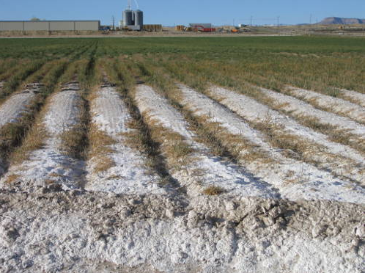
Soils are under threat
erosion
Unsuitable land use practices
Tillage can lead to wind and water erosion of the soil
Heavy machinery can lead to compaction of the soil
Chemical additives can lead to acidification of the soil
Change in plant community can lead to water evaporation and salinization of the soil
compaction
salinization

